Slide 1
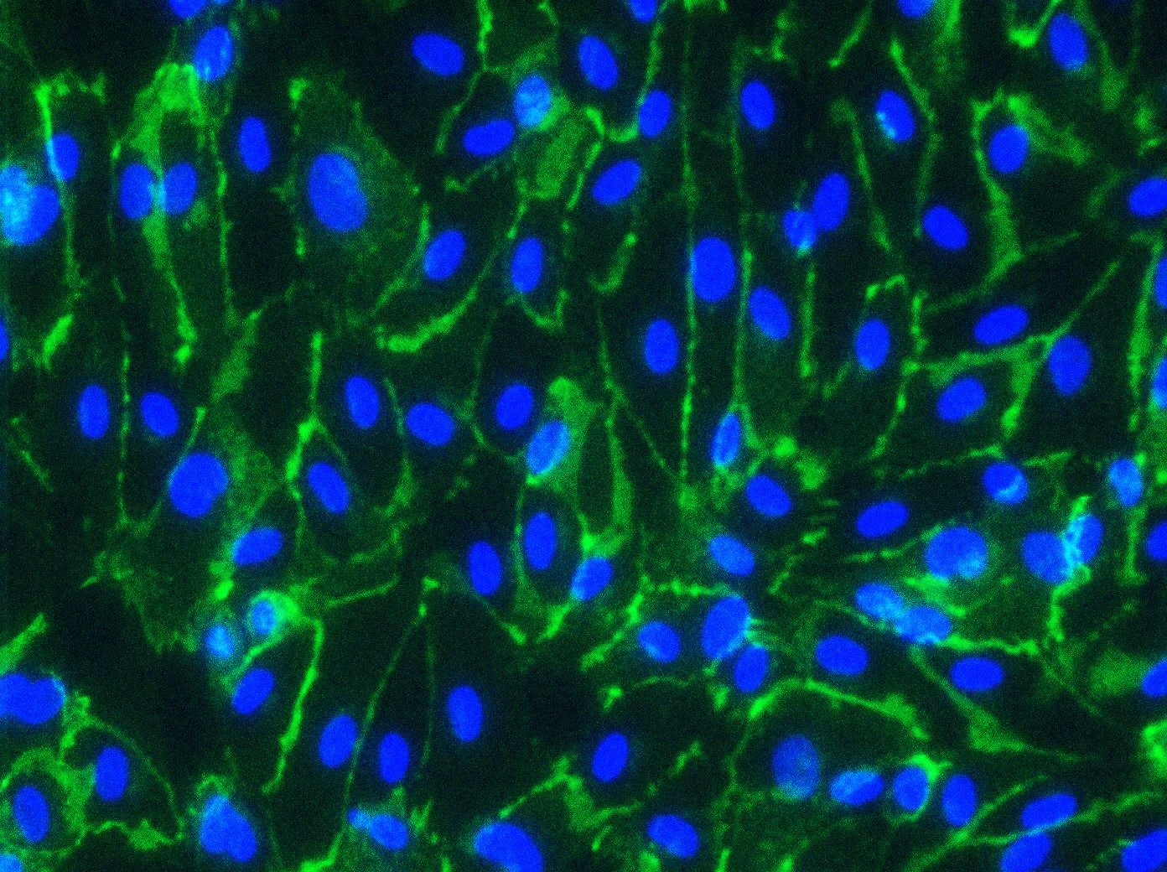
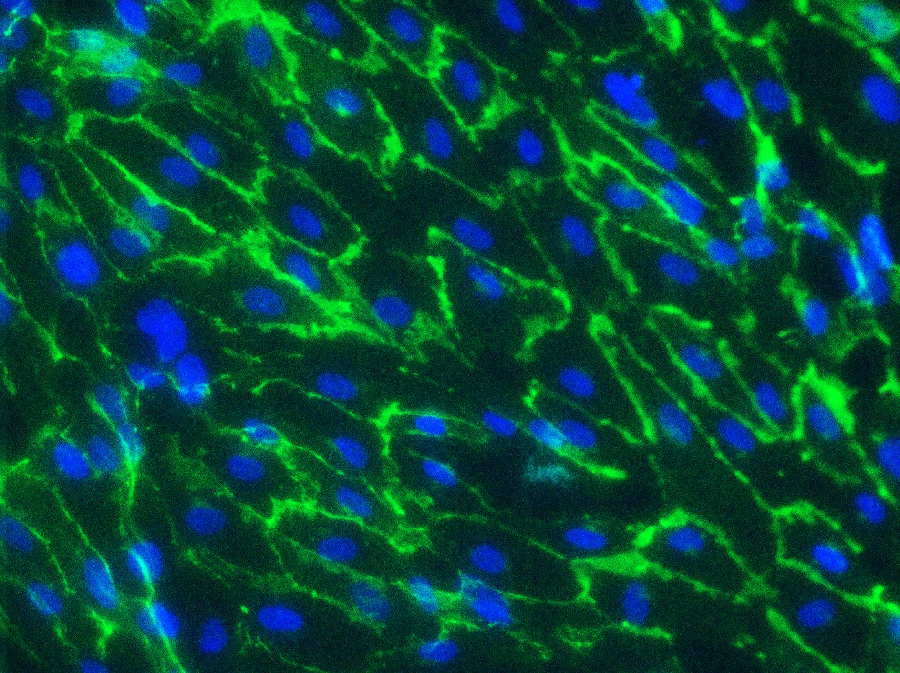
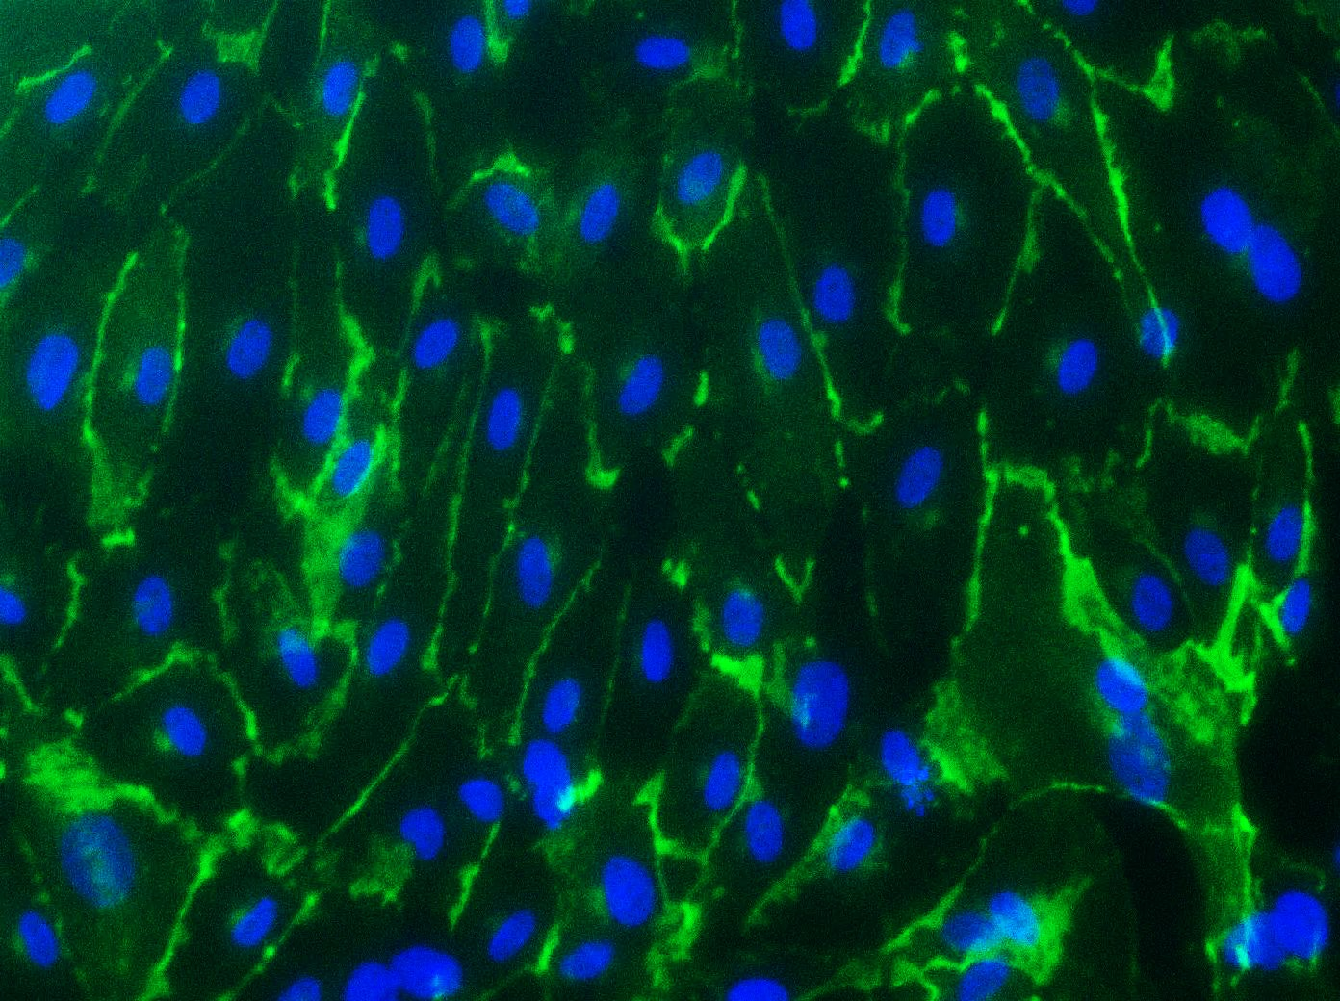
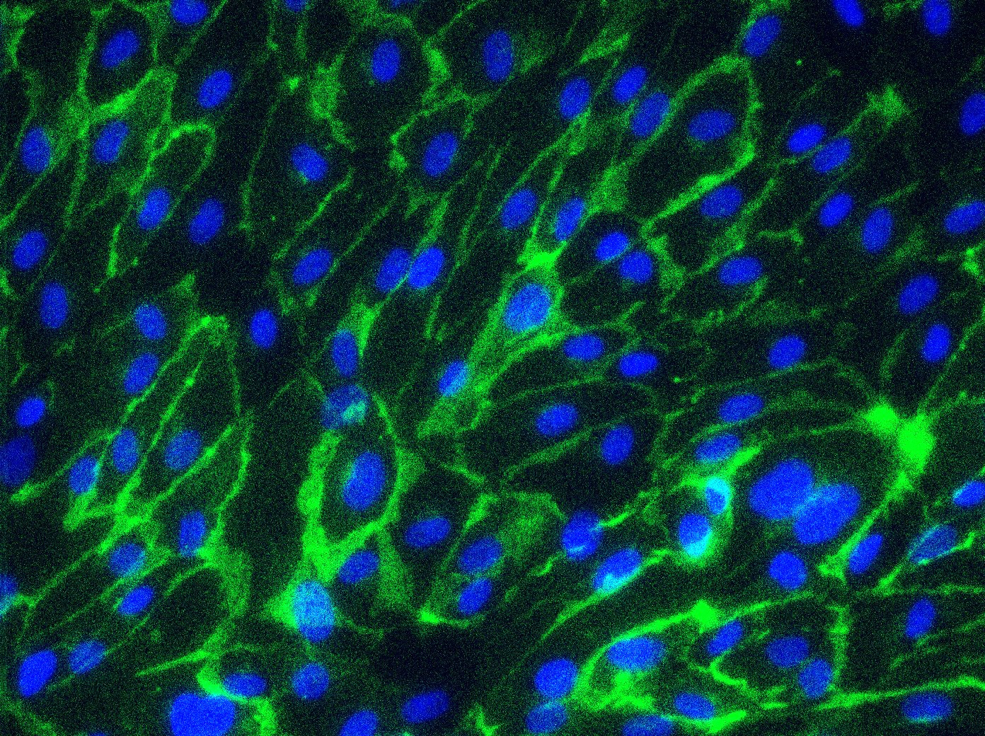
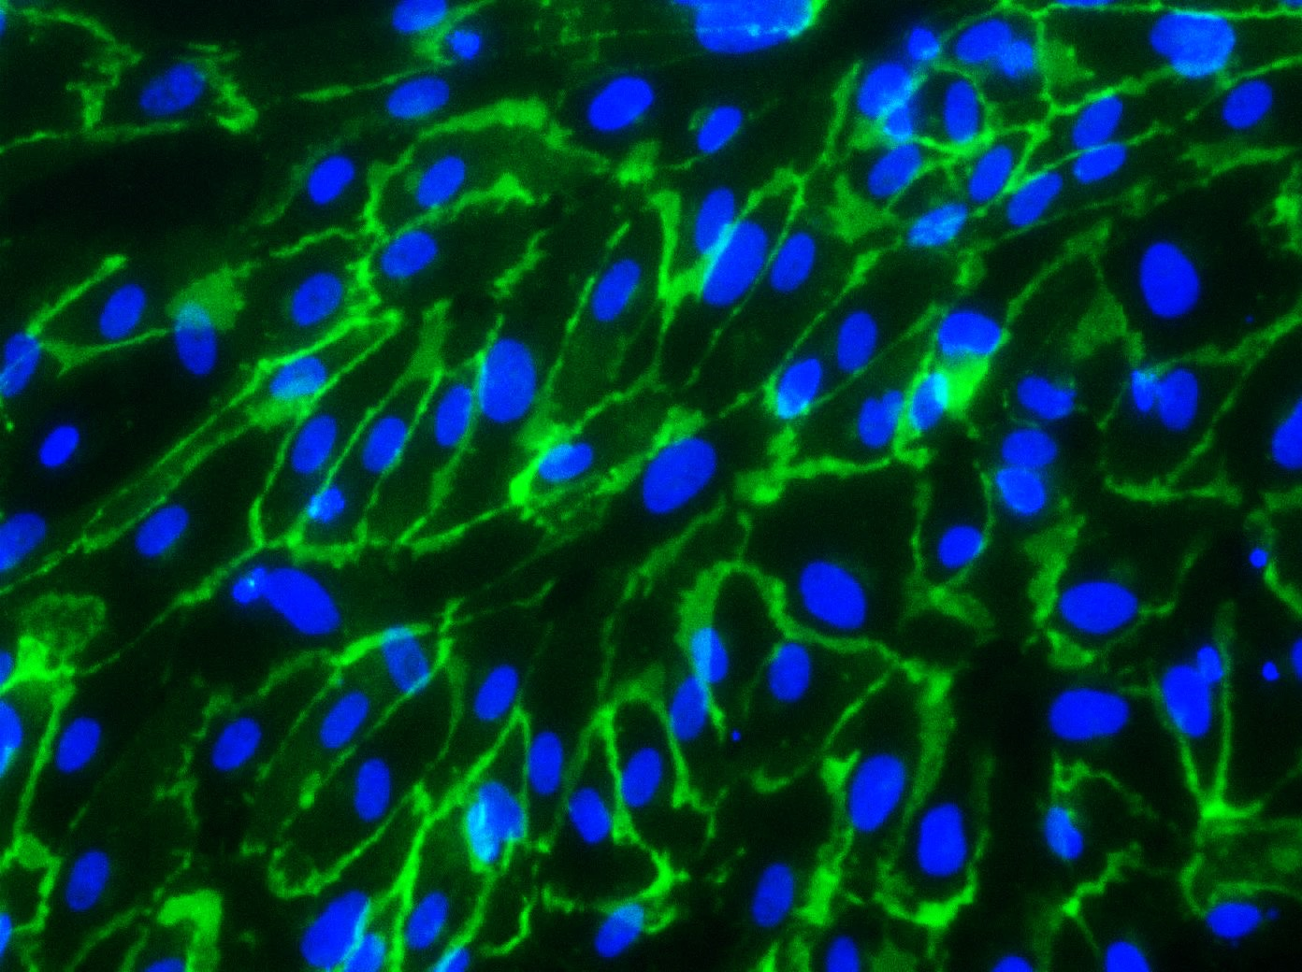
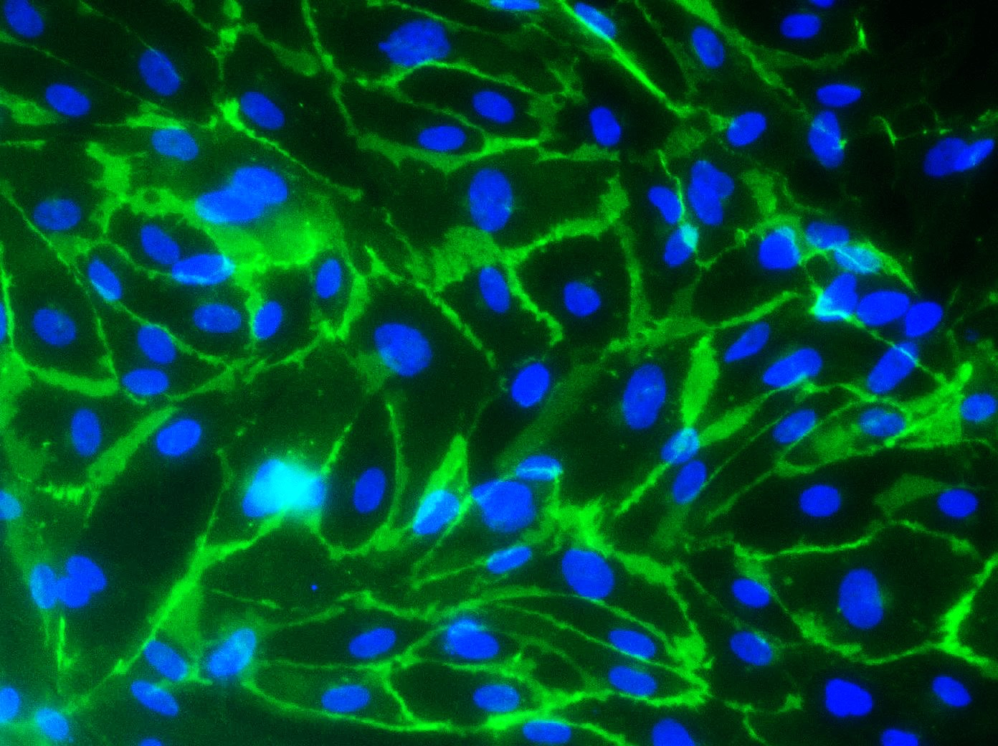
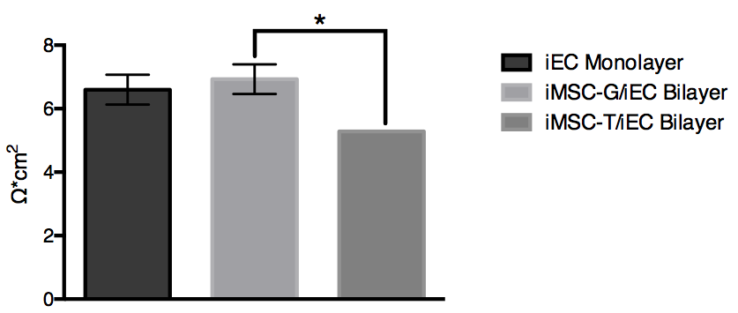
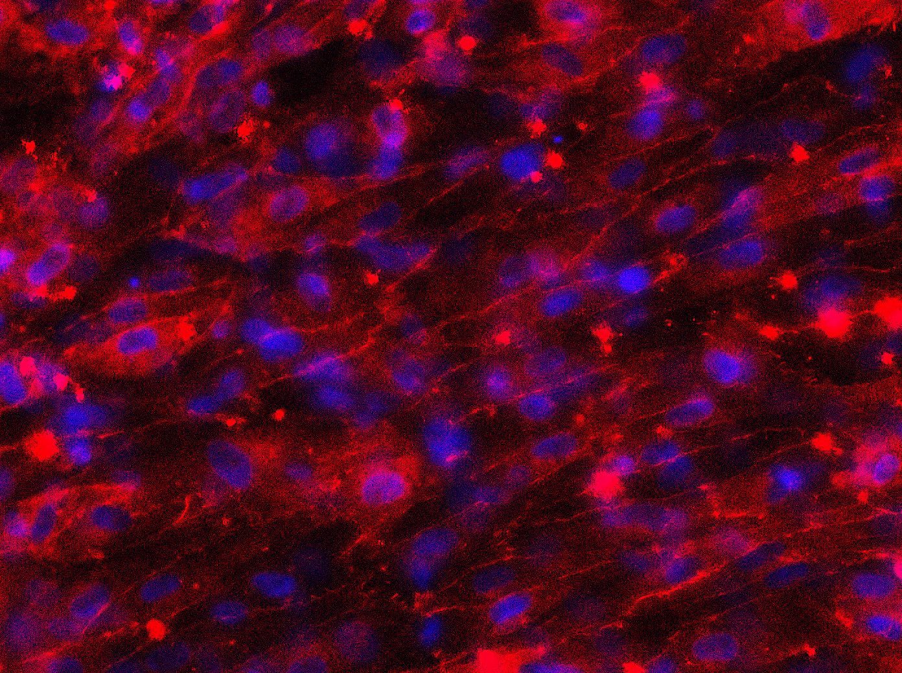
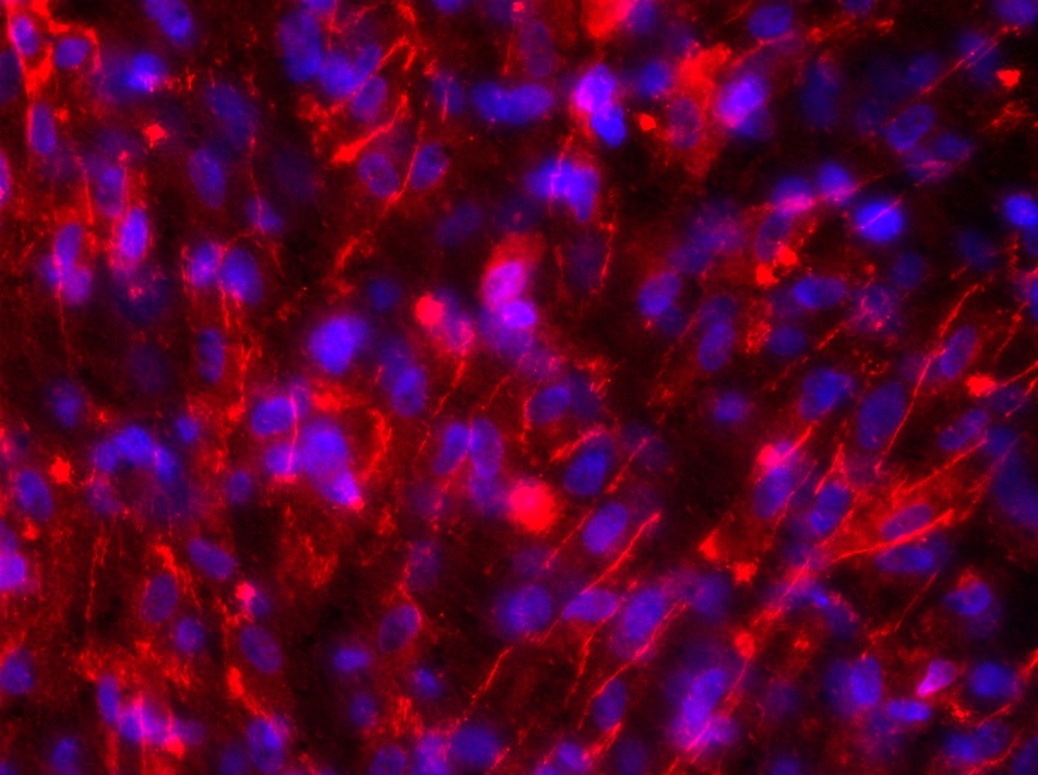
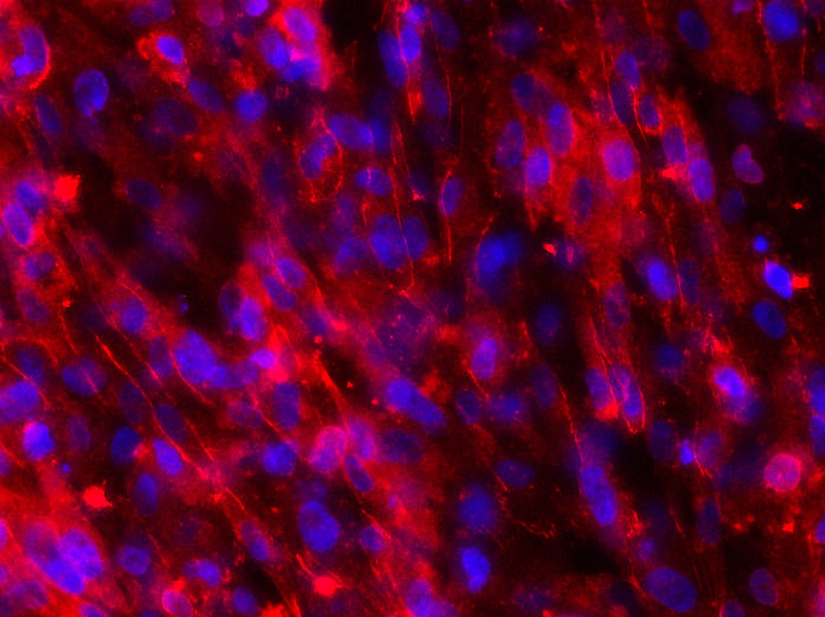
iEC-G
iMSC-G-Cond
iMSC-T-Cond
Figure 12. Protein expression of iEC-G, iMSC-G-Cond, iMSC-B-Cond, and iMSC-T-Cond on culture day 3 (top) and culture day 6 (bottom). Images taken at 20X magnification showing expression of VE-cadherin (green) and DAPI (blue).
Figure 13. Analysis of TEER readings of iEC Monolayer, iMSC-G/iEC Monolayer, iMSC-B/iEC Monolayer, and iMSC-T/iEC Monolayer on culture day 6,*p<0.05 one-way ANOVA
iEC
Monolayer
iMSC-G/iEC Bilayer
iMSC-T/iEC Bilayer
Figure 14. Protein expression of iEC Monolayer, iMSC-G/iEC Monolayer, iMSC-B/iEC Monolayer, and iMSC-T/iEC Monolayer on culture day 13. Images taken at 20X magnification showing expression of ZO-1 (red) and DAPI (blue)

